Slide 1
Subject : Fundamentals of Java Programming Unit – 5 Multithreading & Exception Handling

Slide 2
Multithreading
Introduction to Thread
Creation of Thread Life
cycle of Thread
Stopping and Blocking a thread
Using Thread Methods
Thread Priority
Thread Synchronization
DeadLock

Slide 3
INTRODUCTION TO THREAD
Process and Thread are two basic units of Java program execution.
Process: A process is a self contained execution environment and it can be seen as a program or application.
Thread: It can be called lightweight process
Thread requires less resources to create and exists in the process
Thread shares the process resources

Slide 4
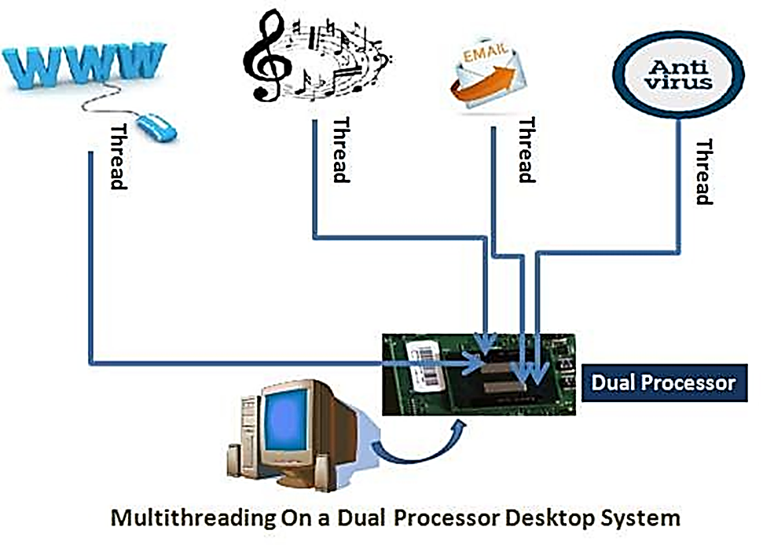
MULTITHREADING
Multithreading in java is a process of executing multiple processes simultaneously
A program is divided into two or more subprograms, which can be implemented at the same time in parallel.
Multiprocessing and multithreading, both are used to achieve multitasking.
Java Multithreading is mostly used in games, animation etc.

Slide 5
Advantages of Multi-Treading
It doesn't block the user
It can perform many operations together so it saves time.
Threads are independent so it doesn't affect other threads

Slide 6
CREATING THREAD
Threads are implemented in the form of objects.
The run() and start() are two inbuilt methods which helps to thread implementation
The run() method is the heart and soul of any thread
It makes up the entire body of a thread
The run() method can be initiating with the help of start() method.
Creating Thread by using two method
By extending thread class
By implementing runnable interface

Slide 7
Continue….
CREATING THREAD
1.
By Extending Thread Class
class Multi extends Thread
{
public void run()
{
System.out.println("thread is running...");
}
// Extending thread class
// run() method declared
public static void main(String args[])
{
Multi t1=new Multi();
t1.start();
}
}
//object initiated
// run() method called through start()
Output: thread is running…

Slide 8
CREATING THREAD Contd.
2. By implementing Runnable interface
▪ Define a class that implements Runnable interface.
▪ The Runnable interface has only one method, run(), that is to be defined in the method with the code to be executed by the thread.

Slide 9
CREATING THREAD Contd.
2. By implementing Runnable interface
class Multi3 implements Runnable
{
public void run()
{
System.out.println("thread is running...");
}
public static void main(String args[])
{
Multi3 m1=new Multi3();
Thread t1 =new Thread(m1);
t1.start();
}
}
// Implementing Runnable interface
// object initiated for class
// object initiated for thread
Output: thread is running…

Slide 10
LIFE cycle of a thread
During the life time of a thread, there are
many states it can enter.
They include:
1. Newborn state
2. Runnable state
3. Running state
4. Blocked state
5. Dead state

Slide 11
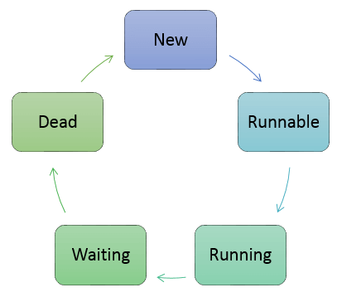
LIFE cycle of a thread

Slide 12
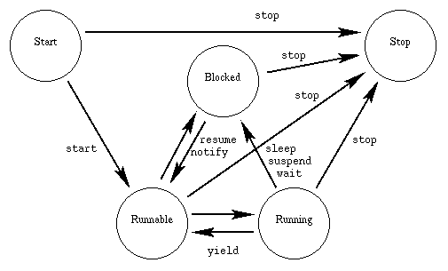
Life cycle of Thread

Slide 13
Life cycle of Thread continue….
New/Start:
This is the state the thread is in after the Thread instance has been created, but the start() method has not been invoked on the thread. It is a live Thread object, but not yet a thread of execution. At this point, the thread is considered not alive.
Runnable:
This means that a thread can be run when the time-slicing mechanism has CPU cycles available for the thread. Thus, the thread might or might not be running at any moment, but there’s nothing to prevent it from being run if the scheduler can arrange it. That is, it’s not dead or blocked.
Running:
This state is important state where the action is. This is the state a thread is in when the thread scheduler selects it (from the runnable pool) to be the currently executing process. A thread can transition out of a running state for several reasons, including because "the thread scheduler felt like it". There are several ways to get to the runnable state, but only one way to get to the running state: the scheduler chooses a thread from the runnable pool of thread.

Slide 14
Life cycle of Thread continue….
Blocked:
The thread can be run, but something prevents it. While a thread is in the blocked state, the scheduler will simply skip it and not give it any CPU time. Until a thread reenters the runnable state, it won’t perform any operations. Blocked state has some sub-states as below,
Blocked on I/O:
The thread waits for completion of blocking operation. A thread can enter this state because of waiting I/O resource. In that case, the thread sends back to runnable state after the availability of resources.
Blocked for join completion: The thread can come in this state because of waiting for the completion of another thread.
Blocked for lock acquisition: The thread can come in this state because of waiting for acquire the lock of an object.
Dead:
A thread in the dead or terminated state is no longer schedulable and will not receive any CPU time. Its task is completed, and it is no longer runnable. One way for a task to die is by returning from its run( ) method, but a task’s thread can also be interrupted, as you’ll see shortly.

Slide 15
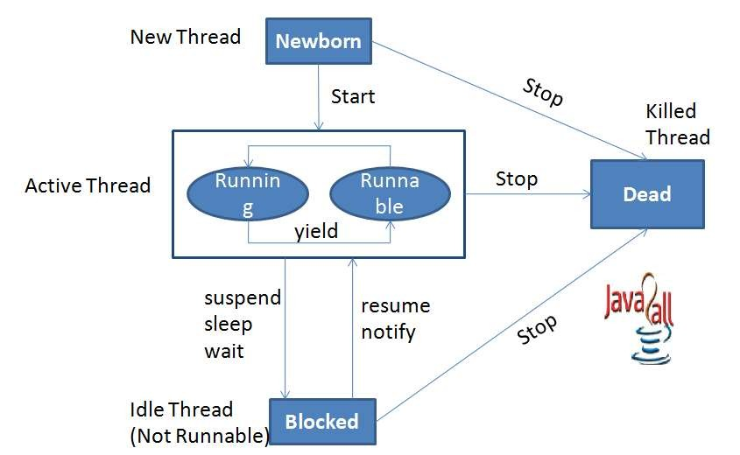
LIFE cycle of a thread contd.

Slide 16
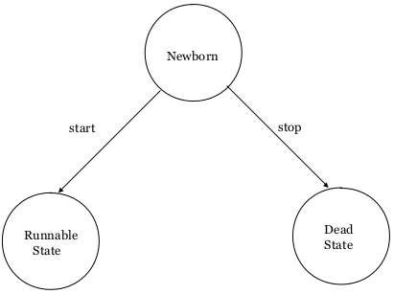
LIFE cycle of a thread contd….
Newborn State:
The thread is born and is said to be in newborn state.
The thread is not yet scheduled for running.
At this state, we can do only one of the following:
Schedule it for running using start() method.
Kill it using stop() method.

Slide 17
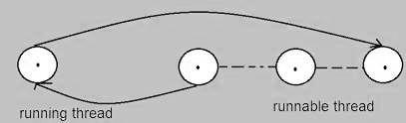
LIFE cycle of a thread contd….
Runnable State:
The thread is ready for execution
Waiting for the availability of the processor.
The thread has joined the queue

Slide 18
LIFE cycle of a thread contd….
Running State:
Thread is executing
The processor has given its time to the thread
for its execution.
The thread runs until it gives up control on its
own or taken over by other threads.

Slide 19
LIFE cycle of a thread contd….
Blocked State:
A thread is said to be blocked
It is prevented to entering into the runnable and the running state.
This happens when the thread is suspended, sleeping, or waiting in order to satisfy certain requirements.
A blocked thread is considered "not runnable" but notdead and therefore fully qualified to run again.
This state is achieved when we Invoke suspend() or sleep() or wait() methods.

Slide 20
LIFE cycle of a thread contd….
Dead State:
Every thread has a life cycle.
A running thread ends its life when it has completed executing its run( ) method. It is a natural death.
A thread can be killed in born, or in running, or even "not runnable" (blocked) condition.
It is called premature death.
This state is achieved when we invoke stop() method or the thread completes it execution.

Slide 21
Thread methods
Thread is a class found in java.lang package
Method Signature | Description
String getName() | Retrieves the name of running thread in the current context in String format
void start() | This method will start a new thread of execution by calling run() method of Thread/runnable object.
void run() | This method is the entry point of the thread. Execution of thread starts from this method.
void sleep(int sleeptime) | This method suspend the thread for mentioned time duration in argument (sleeptime in ms)
void yield() | By invoking this method the current thread pause its execution temporarily and allow other threads to execute.
void join() | This method used to queue up a thread in execution. Once called on thread, current thread will wait till calling thread completes its execution
boolean isAlive() | This method will check if thread is alive or dead

Slide 22
Stopping and blocking
Stopping a thread:
To stop a thread from running further, we may do so by calling its stop() method.
This causes a thread to stop immediately and move it to its dead state.
It forces the thread to stop abruptly before its completion
It causes premature death.
To stop a thread we use the following syntax:
thread.stop();

Slide 23
Stopping and blocking
Blocking a Thread:
A thread can also be temporarily suspended or blocked from entering into the runnable and subsequently running state,
sleep(t) // blocked for ‘t’ milliseconds
suspend() // blocked until resume() method is invoked
wait() // blocked until notify () is invoked

Slide 24
Thread priority
Each thread is assigned a priority, which affects the order in which it is scheduled for running.
Java permits us to set the priority of a thread
using the setPriority() method as follows:
ThreadName.setPriority(int Number);
The int Number is an integer value to which the thread's priority is set. The Thread class defines several priority constants:
Public static MIN_PRIORITY = 1
Public static NORM_PRIORITY = 5
Public static MAX_PRIORITY = 10
The default setting is NORM_PRIORITY. Most user-
level processes should use NORM_PRIORITY.

Slide 25
Java synchronization
Generally threads use their own data and methods provided inside their run() methods.
But if we wish to use data and methods outside the thread’s run() method, they may compete for the same resources and may lead to serious problems.
Java enables us to overcome this problem using a technique known as Synchronization.
For ex.: One thread may try to read a record from a file while another is still writing to the same file.
When the method declared as synchronized, Java creates a "monitor" and hands it over to the thread that calls the method first time.
synchronized (lock-object)
{
.......... // code here is synchronized
}

Slide 26
Deadlock
Deadlock describes a situation where two or more threads are blocked forever, waiting for each other.
when two or more threads are waiting to gain control on a resource.
For example:
assume that the thread A must access Method1 before it can release Method2, but the thread B cannot release Method1 until it gets holds of Method2.

Slide 27
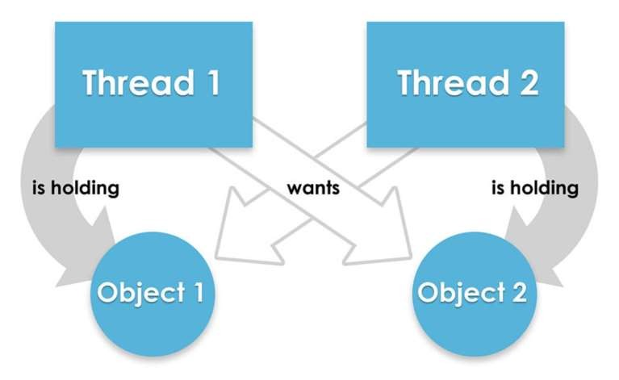
deadlock

Slide 28
Example: Thread creation by extending the Thread class
class MultithreadingDemo extends Thread {
public void run()
{
try {
// Displaying the thread that is running
System.out.println(
"Thread " + Thread.currentThread().getId()
+ " is running");
}
catch (Exception e) {
// Throwing an exception
System.out.println("Exception is caught");
}
}
}
public class Multithread {
public static void main(String[] args)
{
int n = 8; // Number of threads
for (int i = 0; i < n; i++) {
MultithreadingDemo object
= new MultithreadingDemo();
object.start();
}
}
}
OUTPUT:
Thread 15 is running
Thread 14 is running
Thread 16 is running
Thread 12 is running
Thread 11 is running
Thread 13 is running
Thread 18 is running
Thread 17 is running

Slide 29
Exception Handling
- "exception" means "exceptional condition" and is an occurrence that alters the normal program flow.
- The code that's responsible for doing something about the exception is called an "exception handler," and it "catches" the thrown exception.
Example:
1. Invalid data. Trying to Store into a string variable;
2. File that needs to be opened cannot be found.
3. A network connection has been lost in the middle of communications
4. JVM has run out of memory.
5. Divide by zero;
Notes:
29

Slide 30
Exception Handling
For example,
if you call a method that opens a file but the file cannot be opened, execution of that method will stop, and code that you wrote to deal with this situation will be run.
Therefore, we need a way to tell the JVM what code to execute when a certain exception happens.
To do this, we use the try and catch keywords

Slide 31
Java Support for Exception Handling
Throw
Throws
Try
Catch

Slide 32
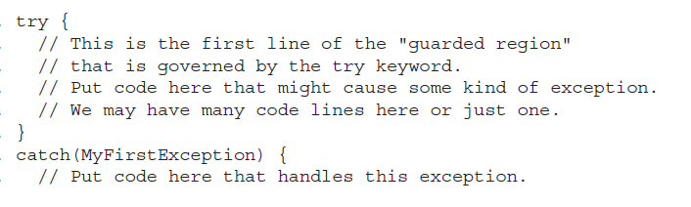
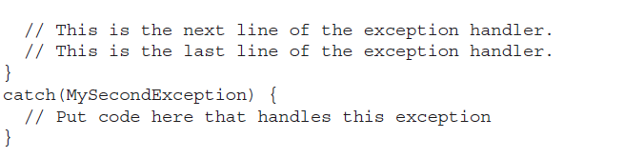
try
The try is used to define a block of code in which exceptions may occur.
One or more catch clauses matching a specific exception will handle the occurred exception.

Slide 33
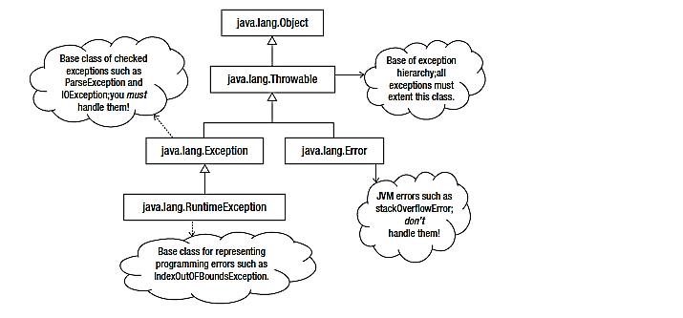
Exceptions Hierarchy

Slide 34
Inheritance hierarchy for class Throwable
Throwable
Exception
Error
RuntimeException
IOException
AWTError
ThreadDeath
OutOfMemoryError

Slide 35
Exception Types

Slide 36
Declaring, Throwing, and Catching Exceptions

Slide 37
Checked Exceptions
Checked exceptions that can be thrown in a method must be caught and handled
OR
declared in the throws clause

Slide 38
Declaring Exceptions
Every method must state the types of checked exceptions it might throw. This is known as declaring exceptions.
public void myMethod() throws IOException
public void myMethod() throws IOException, OtherException

Slide 39
Throwing Exceptions
When the program detects an error, the program can create an instance of an appropriate exception type and throw it. This is known as throwing an exception. Here is an example,
throw new TheException();
TheException ex = new TheException(); throw ex;

Slide 40
Cautions When Using Exceptions
Exception handling separates, error-handling code from normal programming tasks, thus making programs easier to read and to modify.
Exception handling usually requires more time and resources because it requires instantiating a new exception object, rolling back the call stack, and propagating the errors to the calling methods.

Slide 41
When to Throw Exceptions
An exception occurs in a method.
If you want the exception to be processed by its caller, you should create an exception object and throw it.
If you can handle the exception in the method where it occurs, there is no need to throw it.

Slide 42
Key-words used for Exception Handling
Keyword | Description
try | The "try" keyword is used to specify a block where we should place an exception code. It means we can't use try block alone. The try block must be followed by either catch or finally.
catch | The "catch" block is used to handle the exception. It must be preceded by try block which means we can't use catch block alone. It can be followed by finally block later.
finally | The "finally" block is used to execute the necessary code of the program. It is executed whether an exception is handled or not.
throw | The "throw" keyword is used to throw an exception.
throws | The "throws" keyword is used to declare exceptions. It specifies that there may occur an exception in the method. It doesn't throw an exception. It is always used with method signature.

Slide 43
Syntax
try
{
// Block of code to try
}
catch(Exception e)
{
// Block of code to handle errors
}

Slide 44
Example - 1
This will generate an error, because myNumbers[10] does not exist.
public class Main {
public static void main(String[ ] args) {
int[] myNumbers = {1, 2, 3}; System.out.println(myNumbers[10]); // error!
}
}
The output will be something like this:
Exception in thread "main" java.lang.ArrayIndexOutOfBoundsException: 10 at Main.main(Main.java:4)

Slide 45
Example - 2
If an error occurs, we can use try...catch to catch the error and execute some code to handle it:
public class Main {
public static void main(String[ ] args) {
try {
int[] myNumbers = {1, 2, 3};
System.out.println(myNumbers[10]);
}
catch (Exception e) {
System.out.println("Something went wrong.");
}
}
}
The output will be:
Something went wrong.

Slide 46
Example - 3
public class JavaExceptionExample{
public static void main(String args[]){
try{
//code that may raise exception
int data=100/0;
}
catch(ArithmeticException e){
System.out.println(e);
}
//rest code of the program
System.out.println("rest of the code...");
}
}
OUTPUT:
Exception in thread main java.lang.ArithmeticException:/ by zero
rest of the code...

Slide 47
Finally
The finally statement lets you execute code, after try...catch, regardless of the result:
Example :
public class Main {
public static void main(String[] args) {
try {
int[] myNumbers = {1, 2, 3}; System.out.println(myNumbers[10]);
}
catch (Exception e) {
System.out.println("Something went wrong.");
}
finally {
System.out.println("The 'try catch' is finished.");
}
}
}
The output will be:
Something went wrong. The 'try catch' is finished.

Slide 48
The throw keyword
The throw statement allows you to create a custom error.
The throw statement is used together with an exception type.
There are many exception types available in Java : ArithmeticException, FileNotFoundException, ArrayIndexOutOfBoundsException, SecurityException, etc:

Slide 49
Example :
Throw an exception if age is below 18 (print "Access denied"). If age is 18 or older, print "Access granted":
public class Main {
static void checkAge(int age) {
if (age < 18) {
throw new ArithmeticException("Access denied - You must be at least 18 years old.");
}
else {
System.out.println("Access granted - You are old enough!");
}
}
public static void main(String[] args) {
checkAge(15); // Set age to 15 (which is below 18...)
}
}
The output will be:
Exception in thread "main" java.lang.ArithmeticException: Access denied - You must be at least 18 years old. at Main.checkAge(Main.java:4) at Main.main(Main.java:12)

Slide 50
The Throws/Throw Keywords
If a method does not handle a checked exception, the method must declare it using the throws keyword. The throws keyword appears at the end of a method's signature.
You can throw an exception, either a newly instantiated one or an exception that you just caught, by using the throw keyword.
Try to understand the difference between throws and throw keywords, throws is used to postpone the handling of a checked exception and throw is used to invoke an exception explicitly.
The following method declares that it throws a RemoteException −
Example:
import java.io.*;
public class className {
public void deposit(double amount) throws RemoteException
{
// Method implementation
throw new RemoteException();
}
// Remainder of class definition
}

Slide 51
Comparison Between Throw and Throws
Sr. no. | Basis of Differences | throw | throws
1. | Definition | Java throw keyword is used throw an exception explicitly in the code, inside the function or the block of code. | Java throws keyword is used in the method signature to declare an exception which might be thrown by the function while the execution of the code.
2. |  | Type of exception Using throw keyword, we can only propagate unchecked exception i.e., the checked exception cannot be propagated using throw only. | Using throws keyword, we can declare both checked and unchecked exceptions. However, the throws keyword can be used to propagate checked exceptions only.
3. | Syntax | The throw keyword is followed by an instance of Exception to be thrown. | The throws keyword is followed by class names of Exceptions to be thrown.
4. | Declaration | throw is used within the method. | throws is used with the method signature.
5. | Internal implementation | We are allowed to throw only one exception at a time i.e. we cannot throw multiple exceptions. | We can declare multiple exceptions using throws keyword that can be thrown by the method. For example, main() throws IOException, SQLException.

Slide 52
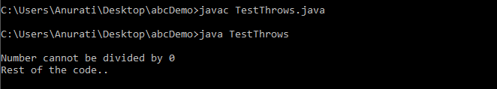
Java throws Example
public class TestThrows {
//defining a method
public static int divideNum(int m, int n) throws ArithmeticException {
int div = m / n;
return div;
}
public static void main(String[] args) { //main method
TestThrows obj = new TestThrows();
try {
System.out.println(obj.divideNum(45, 0));
}
catch (ArithmeticException e){
System.out.println("\nNumber cannot be divided by 0");
}
System.out.println("Rest of the code..");
}
}

Slide 53
Standard Stream
I/O basics, Reading console inputs, Writing Console output.
System.in – read from Keyboard
System.out- display data on console
System.err- display error messages
import java.lang.*;
java.lang

Slide 54
System.out
System.out is a PrintStream to which you can write characters.
It outputs the data you write to the console.
System.out.print()
System.out.println()
System.out.printf ()

Slide 55
System.in
System.in is an InputStream which is connected to keyboard
Java application read input through keyboard using System.in
Scanner class
BufferedReader class

Slide 56
Stream and Types of Stream
What is Stream:
continuous flow of data/sequence of data
OR
Stream is a logical connection between a java application and source-destination, through which we read data from a source and can store data into a destination .

Slide 57
class addition
{
public static void main(string[] args)
{
int a=2;
int b=3;
int c=a+b;
System.out.print(c);
}
}

Slide 58
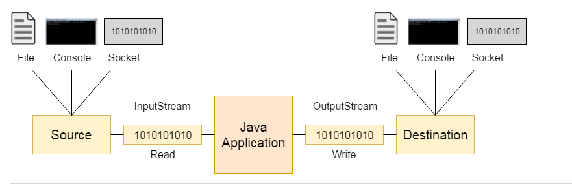
Input and Output Stream

Slide 59
Types of stream
Modern version of Java define two types of streams: byte and character
Byte Stream: provide convenient means for handling input and output of bytes
Character Stream: designed for handling input and output of characters

Slide 60
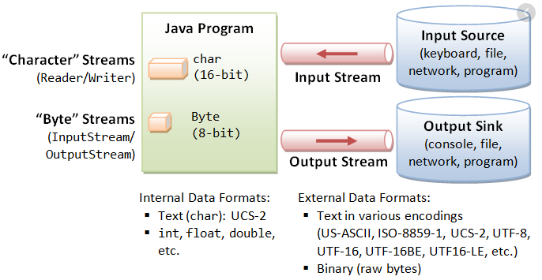
Continued…

Slide 61
Difference
Byte Stream | Char Stream
Reads data byte by byte | Read data character by character
Not Supports Unicode characters | Supports Unicode characters
Used for inputting and outputting the bytes | Used for inputting and outputting the char
Two classes :InputStream and OutputStream | Two classes :Reader and Writer

Slide 62


IO Hierarchy
Stream
Byte Stream
Char Stream
Input
Stream
Output Stream
Reader
Writer
Read ()
Write ()

Slide 63
Reading console input in java
In java, there are three ways to read console input. Using the 3 following ways, we can read input data from the console.
Using BufferedReader class
Using Scanner class
Using Console class

Slide 64
1. Reading console input using BufferedReader class in java
Reading input data using the BufferedReader class is the traditional technique.
This way of the reading method is used by wrapping the System.in (standard input stream) in an InputStreamReader which is wrapped in a BufferedReader, we can read input from the console.
The BufferedReader class has defined in the java.io package.

Slide 65
Consider the following example code to understand how to read console input using BufferedReader class.
import java.io.*;
public class ReadingDemo {
public static void main(String[] args) throws IOException {
BufferedReader in = new BufferedReader(new InputStreamReader(System.in)); String name = “ ";
try
{
System.out.print ("Please enter your name : ");
name = in.readLine();
System.out.println ("Hello, " + name + "!"); }
catch(Exception e) {
System.out.println(e);
}
finally {
in.close();
}
}
}

Slide 66
2. Reading console input using Scanner class in java
Reading input data using the Scanner class is the most commonly used method.
This way of the reading method is used by wrapping the System.in (standard input stream) which is wrapped in a Scanner, we can read input from the console.
The Scanner class has defined in the java.util package.

Slide 67
Consider the following example code to understand how to read console input using Scanner class.
import java.util.Scanner;
public class ReadingDemo {
public static void main(String[] args) {
Scanner in = new Scanner(System.in);
String name = "";
System.out.print ("Please enter your name : ");
name = in.next();
System.out.println("Hello, " + name + "!");
}
}

Slide 68
3. Reading console input using Console class in java
Reading input data using the Console class is the most commonly used method.
This class was introduced in Java 1.6 version.
The Console class has defined in the java.io package.

Slide 69
Consider the following example code to understand how to read console input using Console class.
import java.io.*;
public class ReadingDemo {
public static void main(String[] args) {
String name;
Console con = System.console();
if(con != null) {
name = con.readLine("Please enter your name : "); System.out.println("Hello, " + name + "!!");
}
else
{
System.out.println("Console not available.");
}
}
}

Slide 70
Writing console output in java
In java, there are two methods to write console output.
Using the 2 following methods, we can write output data to the console.
Using print() and println() methods
Using write() method

Slide 71
1. Writing console output using print() and println() methods
The PrintStream is a bult-in class that provides two methods print() and println() to write console output.
The print() and println() methods are the most widely used methods for console output.
Both print() and println() methods are used with System.out stream.
The print() method writes console output in the same line. This method can be used with console output only.
The println() method writes console output in a separete line (new line). This method can be used with console ans also with other output sources.

Slide 72
Let's look at the following code to illustrate print() and println() methods.
public class WritingDemo {
public static void main(String[] args) {
int[] list = new int[5];
for(int i = 0; i < 5; i++)
list[i] = i*10;
for(int i:list)
System.out.print(i); //prints in same line
System.out.println("");
for(int i:list)
System.out.println(i); //Prints in separate lines
}
}

Slide 73
2. Writing console output using write() method
Alternatively, the PrintStream class provides a method write() to write console output.
The write() method take integer as argument, and writes its ASCII equalent character on to the console, it also acept escape sequences.

Slide 74
Let's look at the following code to illustrate write() method.
public class WritingDemo {
public static void main(String[] args) {
int[] list = new int[26];
for(int i = 0; i < 26; i++) {
list[i] = i + 65;
}
for(int i:list) { System.out.write(i);
System.out.write('\n');
}
}
}

Slide 75
Applets
Applet is a special type of program that is embedded in the webpage to generate the dynamic content. It runs inside the browser and works at client side.
An applet is a Java program that runs in a Web browser. An applet can be a fully functional Java application because it has the entire Java API at its disposal.
Advantage of Applet
There are many advantages of applet. They are as follows:
It works at client side so less response time.
Secured
It can be executed by browsers running under many platforms, including Linux, Windows, Mac Os etc.
Drawback of Applet
Plugin is required at client browser to execute applet.

Slide 76
Applets
Applet
Graphical Programming
Layout Manager - Choice, List
Event Handling

Slide 77
Applet
Java programs can be
Standalone apps (command line or GUI)
Web browser applets (run inside web browser)
Applications have main() method, applets don’t
Applets can’t make changes to machine on which they are running
E.g. writing to disk
Hence only small interactive programs
To make web pages more dynamic and interactive

Slide 78
Differences between an applet and a standalone Java application
An applet is a Java class that extends the java.applet.Applet class.
A main() method is not invoked on an applet, and an applet class will not define main().
Applets are designed to be embedded within an HTML page.
When a user views an HTML page that contains an applet, the code for the applet is downloaded to the user's machine.
A JVM is required to view an applet. The JVM can be either a plug-in of the Web browser or a separate runtime environment.
The JVM on the user's machine creates an instance of the applet class and invokes various methods during the applet's lifetime.
Applets have strict security rules that are enforced by the Web browser. The security of an applet is often referred to as sandbox security, comparing the applet to a child playing in a sandbox with various rules that must be followed.
Other classes that the applet needs can be downloaded in a single Java Archive (JAR) file.

Slide 79
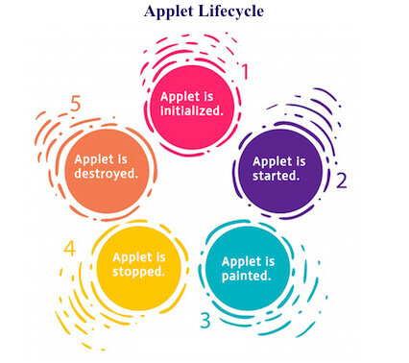
Life cycle of Applet

Slide 80
Life Cycle of an Applet
Four methods in the Applet class gives you the framework on which you build any serious applet −
init − This method is intended for whatever initialization is needed for your applet. It is called after the param tags inside the applet tag have been processed.
start − This method is automatically called after the browser calls the init method. It is also called whenever the user returns to the page containing the applet after having gone off to other pages.
stop − This method is automatically called when the user moves off the page on which the applet sits. It can, therefore, be called repeatedly in the same applet.
destroy − This method is only called when the browser shuts down normally. Because applets are meant to live on an HTML page, you should not normally leave resources behind after a user leaves the page that contains the applet.
paint − Invoked immediately after the start() method, and also any time the applet needs to repaint itself in the browser. The paint() method is actually inherited from the java.awt.

Slide 81
A "Hello World" Applet
Following is a simple applet named HelloWorldApplet.java −
import java.applet.*;
import java.awt.*;
public class HelloWorldApplet extends Applet {
public void paint (Graphics g) {
g.drawString ("Hello World", 25, 50);
}
}
These import statements bring the classes into the scope of our applet class −
java.applet.Applet;
java.awt.Graphics;
Without those import statements, the Java compiler would not recognize the classes Applet and Graphics, which the applet class refers to.
The method paint() gives us access to an object of type Graphics class. Using the object of the Graphics class, we can call the drawString() method of the Graphics class to write a text message in the applet window.

Slide 82
HTML Code
<html>
<Title> Ubale </title>
<applet code="HelloworldApplet.class" width=400 height=400>
</applet>
</html>
Save the file with filename.html
Execution Procedure
Step first: - javac Filename.java
Step second: - appletviewer Filename.html

Slide 83
Alternative Approach
import java.applet.*;
import java.awt.*;
public class Hello extends Applet {
public void paint (Graphics g) {
g.drawString ("Hello World", 250, 250);
}
}
/*<applet code="Hello.class" width=500 height=500>
</applet>*/
Execution Procedure
Step first: - javac Filename.java
Step second: - appletviewer Filename.java

Slide 84
Running an Applet
Browser
AppletViewer

Slide 85
Applets
class of applet package.
Must Import java.applet;
Applets must also import java.awt.
AWT stands for the Abstract Window Toolkit, Since all applets run in a window(Applet Viewer)

Slide 86
Applet Methods
init()
The init( ) method is the first method to be called. This is where you should initialize variables. This method is called only once during the run time of your
start()
The start( ) method is called after init( ). It is also called to restart an applet after it has been stopped
stop()
destroyed()
paint()
The paint( ) method is called each time your applet's output must be redrawn

